Slide 1
ISO 20400
The first international standard on sustainable procurement to achieve best practice

Slide 2
Why an ISO standard on sustainable procurement

Slide 3
Organisations typically spend more than half of their revenues with their supply chains.
Organisation’s budget or revenues
40%
Typical internal spend
100%
60%
Typical spend with supply chains
Sustainability objectives can’t be fully achieved without the contribution of supply chains.

Slide 4
Procurement has a pivotal governance role in managing the organisation’s supply chains.
REQUIREMENTS SCOPE OF WORK BRIEF …
AGREEMENT PURCHASE ORDER CONTRACT …
Supply chains
Stakeholders
ISO 26000
Procurement ISO 20400
Internal stakeholders
Decision makers
Budget Holders
Key functions
Influenced by external stakeholders
Regulator
Communities
NGOs
Individuals with procurement responsibilities
NB: major decisions may not be taken by your ‘procurement’ staff. Anybody involved in procurement decisions is part of the procurement community.
Suppliers
Contractors
Intermediaries
...
All tiers in the supply chains
Procurement is a key mechanism to achieve the sustainability objectives of an organization.

Slide 5
Sustainability and Procurement people struggle to work effectively together…
Sustainability
Environment
Diversity
Ethical Sourcing
WHS
…
Procurement
Sourcing
Buyers
Purchasing
…
Organisations need a robust framework to get all key stakeholders to implement Sustainable Procurement internally

Slide 6
Our economy is global, supply chains are international… We need to speak the same language!
38% of companies consider the lack of a harmonized framework as a key obstacle for sustainable supply chains.
Source: DNV GL, July 2014. Survey conducted on 2,061 professionals from companies across different industries worldwide.

Slide 7
Sustainable procurement is good for business
Sustainable procurement leaders:
90% improve their brand reputation
70% develop stronger, more reliable and longer-lasting supplier relationships
50% have more innovative, sustainable products and services that result in increased sales
45% improved ranking in ‘green’ financial indices
30% delivered cost savings
Source: Ecovadis and HEC, 2017 - 7th Sustainable Procurement Barometer on 120 companies in Europe and the US

Slide 8
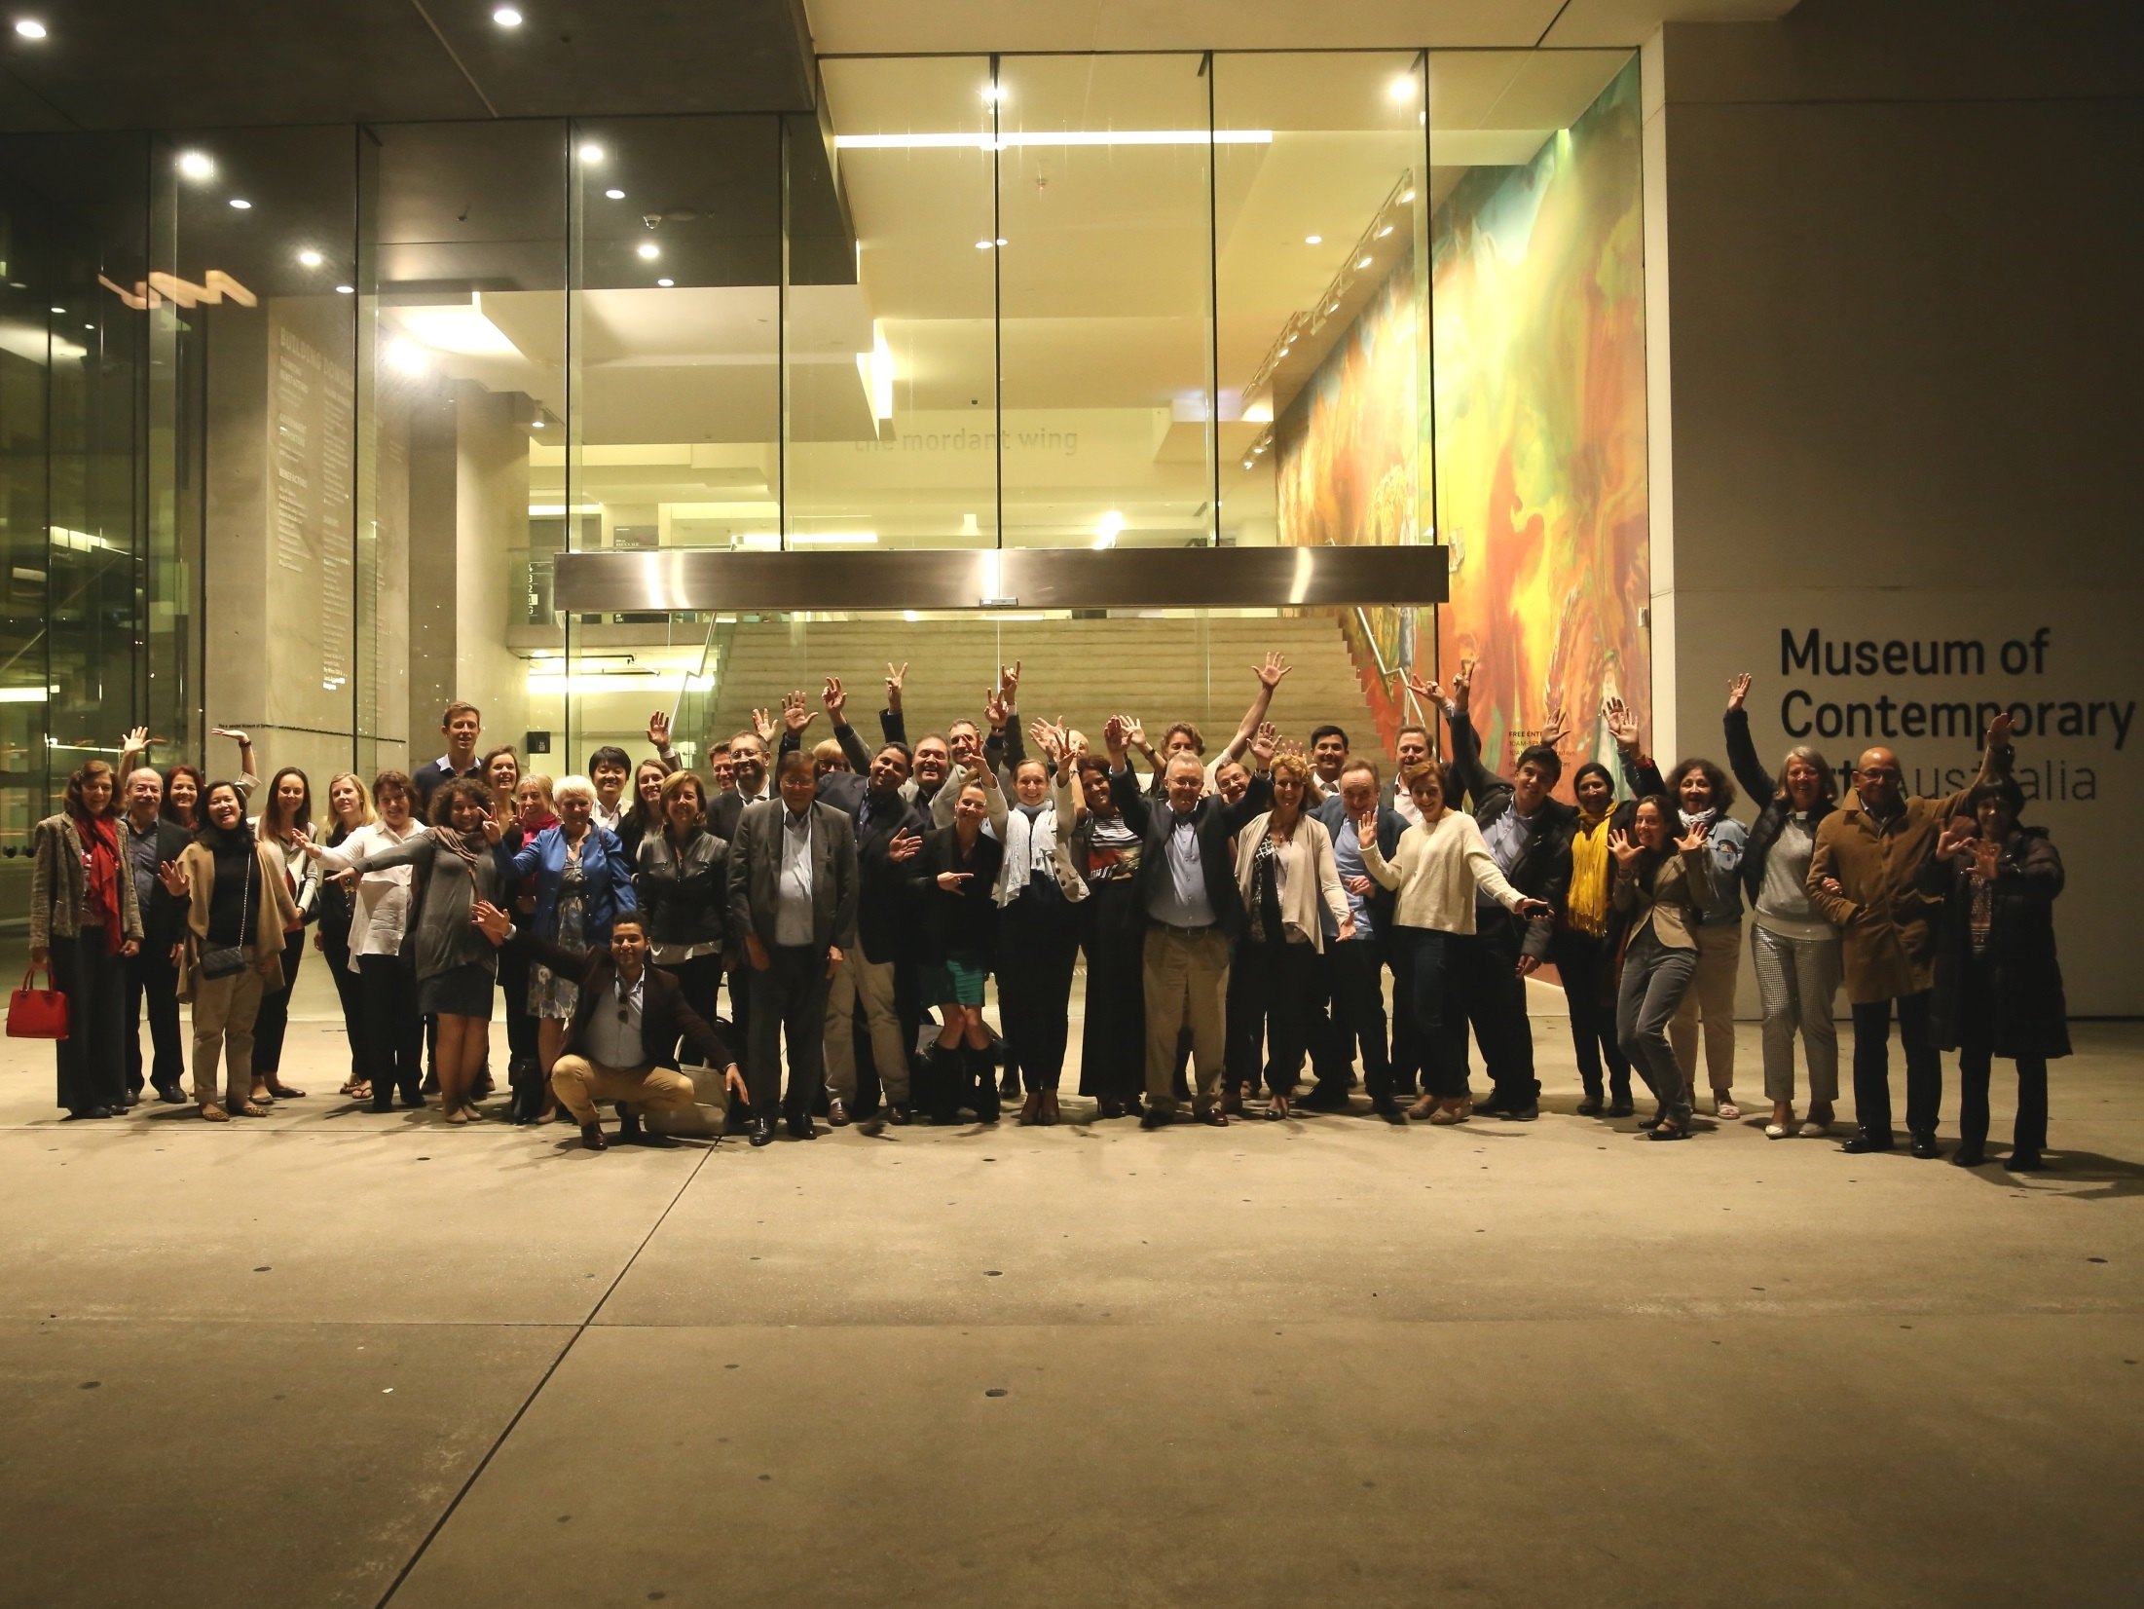
Who developed it and how

Slide 9
52 countries involved through their national standards organisations and under the umbrella of ISO (PC277)
65% world population
85% world GDP
73% world CO2 emissions

Slide 10
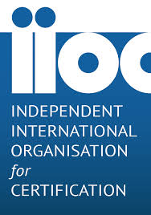
Liaisons with international organisations and ISO standards
International organisations
Liaison committees from ISO / PC277
ISO/TC 207 Environmental Management
ISO/PC 278 Anti-bribery Management System
ISO/TC 262 Risk Management

Slide 11
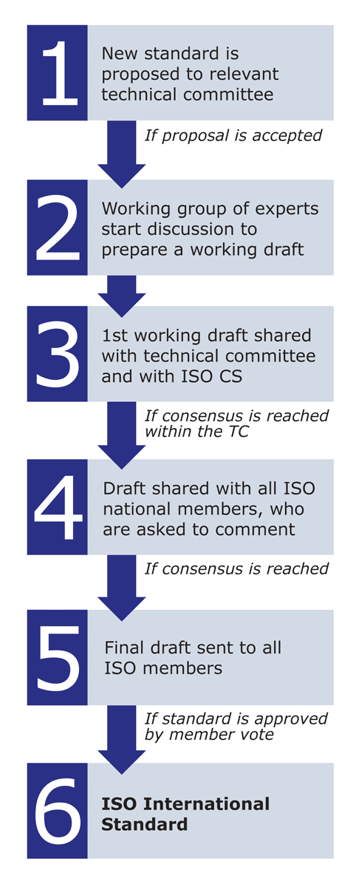
A robust development process
February 2013 – PC 277 is accepted.
French Standard NF X50-135 used as a working draft (other existing standard - British BS 8903)
SEPT 2013 - International Meeting 1 – Paris, France
FEB 2014 - International Meeting 2 – Iguassu, Brazil
NOV 2014 - International meeting 3 – Singapore
JUN 2015 - International meeting 4 – London, UK
MAY 2016 – International Meeting 5 – Sydney, Australia
DEC 2016 – International Meeting 6 – Rio de Janeiro, Brazil

Slide 12
What it is How to use it

Slide 13
What is ISO20400?
ISO guidance standard on SP. It’s a flexible framework.
Provides an understanding of:
what SP is;
How sustainability impacts the different levels of the procurement activity: policy, strategy, organisation, process; and
how to implement SP practically.
Applies to:
any organisation, regardless of its sector, size and location.
any stakeholder involved in or impacted by procurement decisions and processes.
Does not replace legislation, policy and ethical frameworks that regulate procurement activities.

Slide 14
ISO 20400 definition of Sustainable Procurement
‘Procurement
that has the most positive environmental, social & economic impacts possible
over the entire life cycle.’

Slide 15
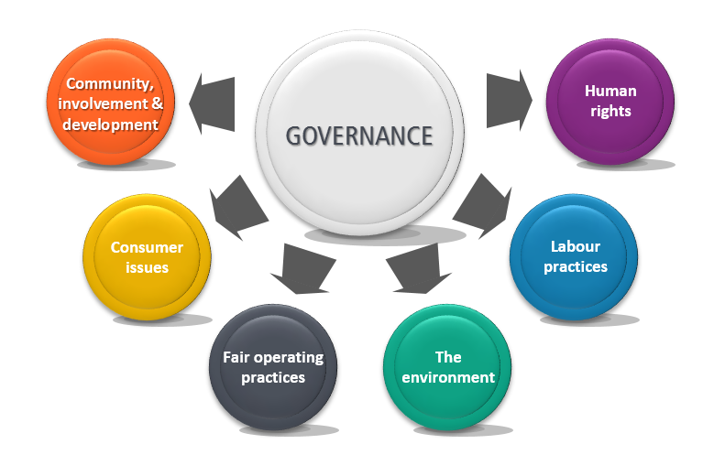
7 core subjects of ISO 20400
Social Responsibility – ISO 26000
7 Core Subjects
Since 2010

Slide 16
ISO 20400: made for Procurement
Final version – Extracts
1. SCOPE
Managing risks
Due diligence
Setting priorities
Avoiding complicity
Exercising influence
2. NORMATIVE REF.
3. DEFINITIONS
Organisation goals
Procurement Context
SP Policy & Strategy
4. FUNDAMENTALS
5. POLICY/STRATEGY
Governance
People
Stakeholders
Priorities
Reporting
Grievance
6. ORGANISATION
7. PROCESS
plan
source
manage

Slide 17
ISO 20400 benefits
Get a practical framework for procurement, CSR and other key functions to work together
Protect your reputation by efficiently managing sustainability risks in their supply chains
Get ahead of future client and regulatory requirements
Take a competitive advantage in your industry by seizing opportunities to innovate
Demonstrate supply chain engagement to GRI, DJSI or other indices

Slide 18
Made for the ISO20400 community
by the ISO20400 community

