Slide 1
ISO 20400
最佳实践“可持续性采购”的第一個国际标准
The first international standard on sustainable procurement to achieve best practice
The original material is written in English. Ir Dannie Yung 翁陳琰嫦工程師 has​ supported the Mandarin Chinese​ translation of this presentation material.

Slide 2
Why an ISO standard on sustainable procurement
为什么出現一個”可持续性采购”的
国际标准

Slide 3
Organisations typically spend more than half of their revenues with their supply chains. 一般而言,組织會花一半以上的收入在供应链上。
Organisation’s budget or revenues
组织的預算或收入
40%
Typical internal spend
典型內部開支
100%
60%
Typical spend with supply chains
在供应链上的典型開支
Sustainability objectives can’t be fully achieved without the contribution of supply chains.
沒有供应链的貢獻，不可能完全達到”可持续发展”的目標

Slide 4
Procurement has a pivotal governance role in managing the organisation’s supply chains. 采购在组织供应链管理有著关键的治理角式。
REQUIREMENTS SCOPE OF WORK BRIEF …
AGREEMENT PURCHASE ORDER CONTRACT …
Stakeholders
持分者
ISO 26000
Procurement
采购
ISO 20400
Supply chains
供应链
Internal stakeholders 內部持分者
Decision makers 決策者
Budget Holders 預算持有者
Key functions关键功能
Influenced by external stakeholders外部持分影响者
Regulator 监管机构
Communities 社会群体
NGOs 非政府组织
Individuals with procurement responsibilities
NB: major decisions may not be taken by your ‘procurement’ staff. Anybody involved in procurement decisions is part of the procurement community.
个別采购負责人
註意:重大决策不能只來自 ‘采购’的 工作人员; 任何一个参与采购决策的人都是采购社群一分子。
Suppliers
Contractors
Intermediaries
...
All tiers in the supply chains
供应商
承包商
中介
...
供应链中的所有层
Procurement is a key mechanism to achieve the sustainability objectives of an organization.
采购是实现组织“可持续发展目标”的一个关键机制。

Slide 5
Sustainability and Procurement people struggle to work effectively together… “可持续发展”和采购人爭扎去有效地一起工作
Sustainability
Environment
Diversity
Ethical Sourcing
WHS
…
Procurement
Sourcing
Buyers
Purchasing
…
“可持续发展”
环境
多元
道德采购
適健安
采购
開拓供應來源
买者
购买…
Organisations need a robust framework to get all key stakeholders to implement Sustainable Procurement internally
组织需要一个強健的框架以得到內部所有主要持分者來一齊实踐
”可持续性采购”

Slide 6
Our economy is global, supply chains are international… We need to speak the same language! 我们的经济是全球性的, 供应链是国际的 ... 我们需要讲同一樣的语言 ！
38% of companies consider the lack of a harmonized framework as a key obstacle for sustainable supply chains.
38%的公司认为缺乏统一和諧的一个框架是
”可持续性供应链”的主要障碍。
Source: DNV GL, July 2014. Survey conducted on 2,061 professionals from companies across different industries worldwide.

Slide 7
Sustainable procurement is good for business “可持续采购”是对企业有利的
Sustainable procurement leaders: “可持续采购” 领先者:
90% improve their brand reputation
90%提高了品牌美誉度
70% develop stronger, more reliable and longer-lasting supplier relationships
70%发展出更强大、 更可靠、 更持久的供应商关系
50% have more innovative, sustainable products and services that result in increased sales
50%有着更具创新性、 可持续的产品和服务，导致销量上增
45% improved ranking in ‘green’ financial indices
45%在 ‘绿色’ 财务指标排名榜上有所上升
30% delivered cost savings
30% 達到降低价格成本。
Source: Ecovadis and HEC, 2017 - 7th Sustainable Procurement Barometer on 120 companies in Europe and the US

Slide 8
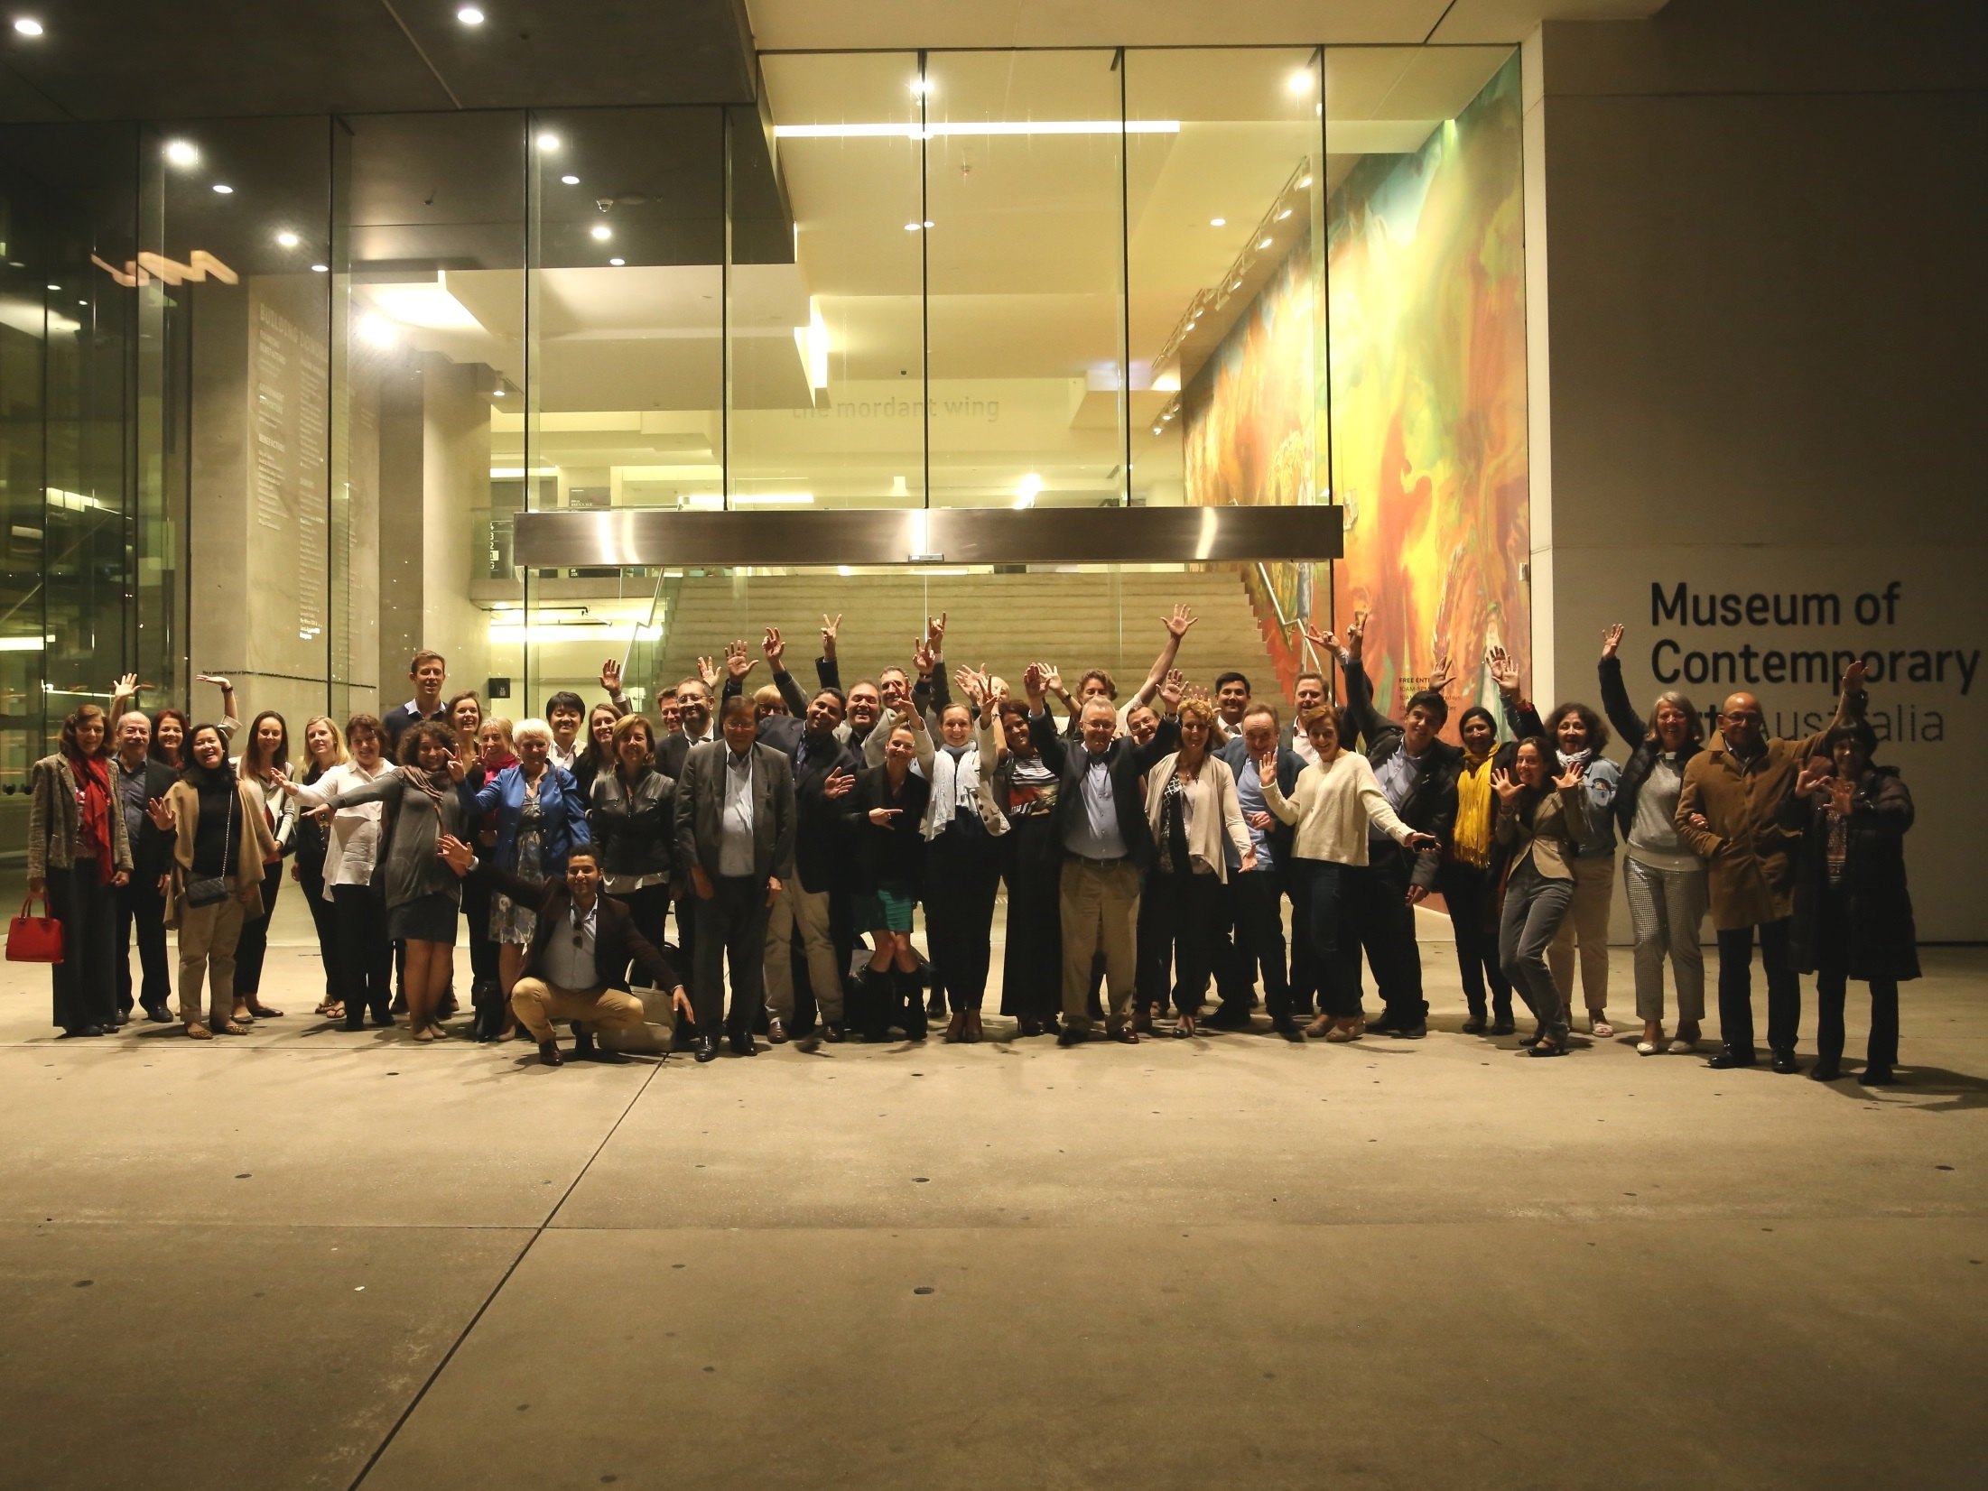
Who developed it and how
誰?如何?開展這出來的

Slide 9
52 countries involved through their national standards organisations and under the umbrella of ISO (PC277) 52 个国家在ISO (PC277)領域下通过各国国家标准组织締造出來的
祕書處
祕書處
參與会員
覌察会員
65% world population
世界的人口
85% world GDP
世界的 GDP
73% world CO2 emissions
世界的碳排放

Slide 10
Liaisons with international organisations and ISO standards 与国际组织和 ISO 标准的联系
International organisations
国际组织
Liaison committees from ISO / PC277
ISO / PC277的联络委員會
ISO/TC 207 Environmental Management .环境管理
ISO/PC 278 Anti-bribery Management System 反贿赂管理系统
ISO/TC 262 Risk Management 风险管理

Slide 11
A robust development process
1 | New standard is proposed to relevant technical committee 向相关技术委员会提出新的标准
 | If proposal is accepted 如建议被接受
2 | Working group of experts start discussion to prepare a working draft 专家工作组展开讨论，以编写一份工作草案
3 | 1st working draft shared with technical committee and with ISO CS 与技术委员会和 ISO CS共享第一次工作草案
 | If consensus is reached within the TC 如在 TC 内达成共识
4 | Draft shared with all ISO national members, who are asked to comment 与所有被要求发表评论的 ISO 国家成员共享草案
 | If consensus is reached 如达成共识
5 | Final draft sent to all ISO members 把最后草案发送给所有 ISO 成员
 | If standard is approved by member vote 如成员投票通过标准
6 | ISO International Standard ISO 国际标准
February 2013 – PC 277 is accepted.
2013年2月 - PC 277被接纳
French Standard NF X50-135 used as a working draft
法國标准 NF X50-135被用作工作草案
(other existing standard - British BS 8903)
(其他現行标准 – 英國 BS 8903)
SEPT 2013 - International Meeting 1 – Paris, France
2013 年 9 月-国际会议 1 — 巴黎，法国
FEB 2014- International Meeting 2 – Iguassu, Brazil
2014 年 2 月国际会议 2 — 伊瓜苏，巴西
NOV 2014 - International meeting 3 – Singapore
2014 年 11 月国际会议 3 — 新加坡
JUN 2015 - International meeting 4 – London, UK
2015 年 6 月国际会议 4 — 伦敦，英国
MAY 2016 – International Meeting 5 – Sydney, Australia
2016 年 5 月国际会议 5 — 悉尼，澳大利亚
DEC 2016 – International Meeting 6 – Rio de Janeiro, Brazil
2016 年 12 月国际会议 6 — 里约热内卢，巴西

Slide 12
啟 動
What it is How to use it
是什么
如何應用

Slide 13
What is ISO20400? “可持续牲采购”的第一個国际标准ISO20400是什麼?
ISO guidance standard on SP. It’s a flexible framework.
是国际标准組織(ISO) 給SP的指导标准. 是一个灵活的框架
Provides an understanding of:提供以下理解
SP是什麼
可持续发展对不同层次的采购活动的影响︰ 方針、 策略、 组织、 过程
如何实祭体现 SP
what SP is;
How sustainability impacts the different levels of the procurement activity: policy, strategy, organisation, process; and
how to implement SP practically.
Applies to适用於:
任何组织，不论其部门、 大小和所在地
- 任何參与於或被采购决策和过程影响利的相关持分者
any organisation, regardless of its sector, size and location.
any stakeholder involved in or impacted by procurement decisions and processes.
Does not replace legislation, policy and ethical frameworks that regulate procurement activities. 並不替代规范采购活動 的立法、 政策和道德框架

Slide 14
ISO 20400 definition of Sustainable Procurement
ISO 20400 “可持续采购”的定义
‘最能夠在整個生命周期內
為
环境、社会及经济 層次上
做造出正面影响的
采购 '。
‘Procurement
that has the most positive environmental, social & economic impacts possible
over the entire life cycle.’

Slide 15
7 core subjects of ISO 20400
ISO 20400 的 7 个核心科目
Community, involvement & development
社會群組的參与
Human rights
人權
GOVERNANCE
管治
Consumer issues
消费者關注
Labour practices
劳工
Fair operating practices
公平運營交易
The environment
环境
社会責任 Social Responsibility – ISO 26000
7 Core Subjects 7 个核心科目
Since 2010 源自 2010年

Slide 16
ISO 20400: made for Procurement ISO 20400: 為采期购打造的
Final version – Extracts 最终版本摘錄
SCOPE
范围
Managing risks
风险管理
Due diligence
尽职调查
Setting priorities
優先排序
Avoiding complicity避免共犯/牵連
Exercising influence
使出/運用影响
2. NORMATIVE REF.
范鍳參巧
3. DEFINITIONS
定義
Organisation goals
组织的目標
Procurement Context
采购处情
SP Policy & Strategy
SP方针及策略
4. FUNDAMENTALS
基礎
5. POLICY/STRATEGY
方針/策略
Governance
管治
People
人員
Stakeholders
技分者
Priorities
優先次序
Reporting
报告
Grievance
伸訴
6. ORGANISATION
组织
7. PROCESS
过程
Plan
计划
Source
采购
Manage
管理

Slide 17
ISO 20400 benefits ISO 20400的好处
得到一个采购、 企业社会责任和其他关键功能一起合作的实际框架 Get a practical framework for procurement, CSR and other key functions to work together
通过有效地管理供应链的相關可持续性风险以保护企業的名誉Protect your reputation by efficiently managing sustainability risks in their supply chains
走先在客户將來需要及監管要求之先Get ahead of future client and regulatory requirements
抓住机遇创新,締造在行业中的竞争优势，Take a competitive advantage in your industry by seizing opportunities to innovate
证明自身供应链參与全球指標性报告, 包括 GRI、 DJSI 或其他量度基准。Demonstrate supply chain engagement to GRI, DJSI or other indices

Slide 18
由 ISO20400 社群為 ISO20400 社群締造的
Made for the ISO 20400 community
by the ISO 20400 community

