Slide 1
Steering Group Data Report Tuesday 16th Jan 2024

Slide 2
Our mission statement …
ISO20400.org is a not-for-profit, free to access platform which aims to develop a global community of practice around ISO 20400 and sustainable procurement.
Thank you for supporting us !

Slide 3
We are still doing all of this
Who | How | Progress
Targeting Procurement and sustainability professionals | 1:1 engagement, social media, events, marketing | Growth Agency is attracting more users to the website from 12 prioritised countries. We are using Mailchimp newsletters We are refining what is promoted We use social media weekly We are creating podcasts weekly
Business leaders (C Suite) | Targeted engagement through marketing channels, high level events, articles | Our recent videos and podcasts about environmental topics and human rights have proved very popular.
Schools/colleges/universities | Potentially sponsored study in Canada and New Zealand | We are continuing to explore these possibilities with Anne Staal and Luc Bres Encouraging use of ISO20400.org resources in teaching and research We have also made connections with other Universities via their procurement personnel.
Beginners, people given the job to implement SP | 1:1 engagement, recommending resources, social media, events, groups, awards, competitions | Upgrading the Self-Assessment to provide audio guidance is continuing, were at the coding stage now and hope to be completed by March 2024 Video guidance is already posted Shaun to feedback

Slide 4
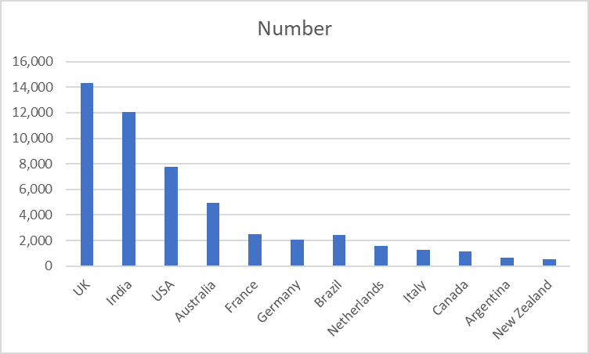
Growth Agency
ASCIC are working with Growth Agency.
The Google Ads & Bing campaigns are increasing traffic to the website traffic and website engagement. This is measured through the number of new users to the website, resources accessed, conversion goals such as user registrations, contact form fills, newsletter sign-ups, email clicks, and clicks to their social media platforms (Twitter, Facebook, and LinkedIn).
All of these numbers are up considerably.

Slide 5
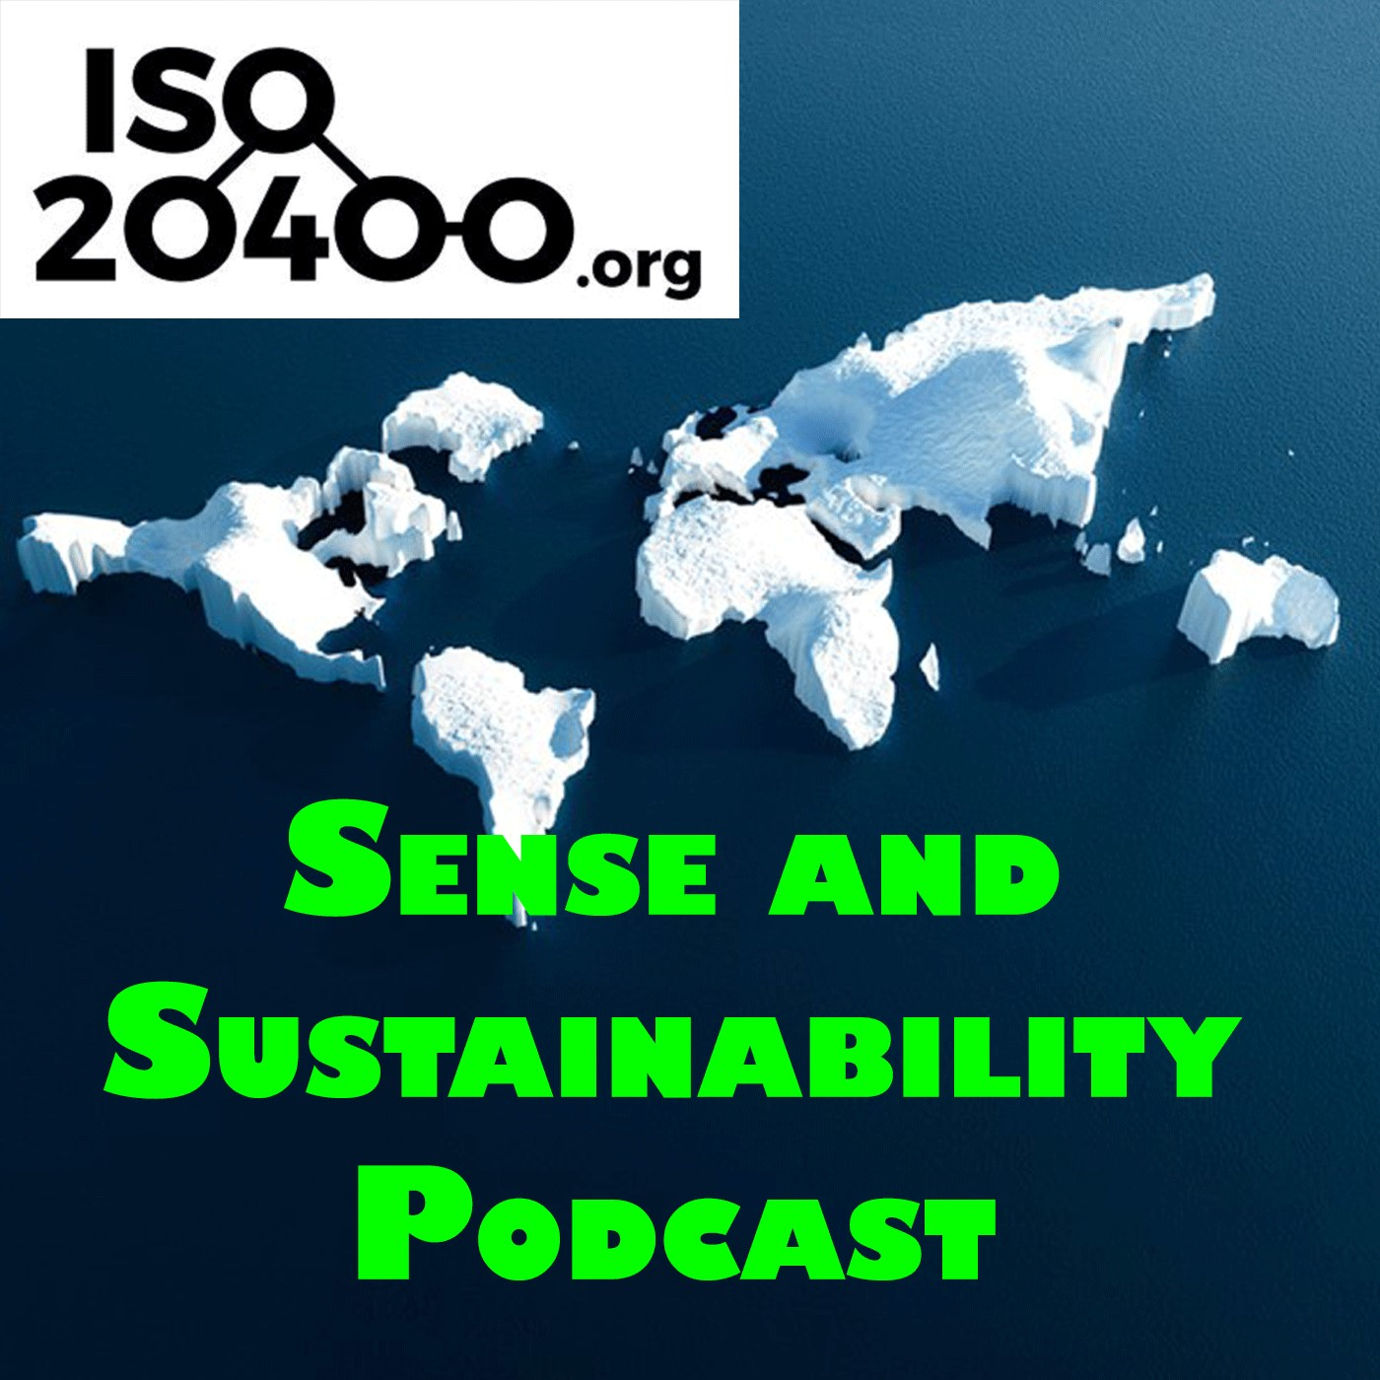
31 Platforms being used
66 Countries in total
493 cities in total
2751 Total downloads
Top 5 Countries: 1st United Kingdom 911, 2nd USA 354, 3rd Australia 278, 4th Canada 99, 5th Netherlands 87
Top 5 platforms: 1st Apple podcasts 814, 2nd Spotify 697, 3rd party apple apps 340, 4th Audible 229, 5th Buzzsprout 135
.

Slide 6
Top 3 episodes: 1st Episode 3 - Should sustainable procurement cost more? 222,
2nd Episode 2 - Sustainable procurement it doesn't matter what you call it 207,
3rd Episode 1 - An Introduction to the Podcast 183,
4th Episode 5 - Sustainable procurement international review 173,
5th Episode 4 - ISO 20400 - Do you really need a certificate on the wall? 152

Slide 7
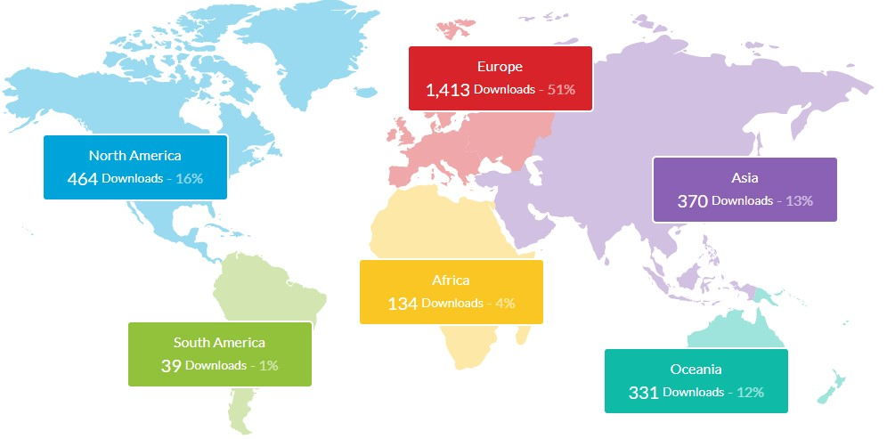

Slide 8
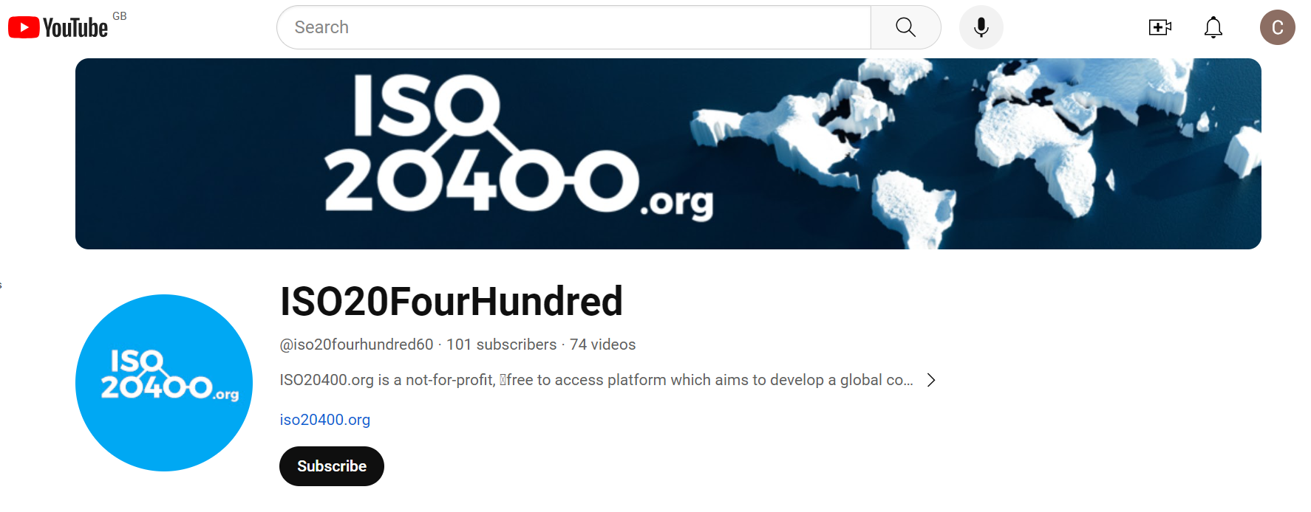

Slide 9
YouTube Stats -
101 Subscribers
6,061 Views
89.9 Hours watched
Top 3 closed caption translations: 1st English, 2nd Chinese, 3rd Arabic
Subscription Ratio: Non subscribed 90.9% and Subscribed 9.1%
Top 5 YouTube Episodes:
1st - 5 Years of ISO20400 1,280
2nd Sustainable Procurement Guidance Standards Webinar 297
3rd Episode 18 - SPLC summit with Josh Jacobs 245
4th Plastic packaging tax 198
5th Podcast EP 10 - Sanjay Kumar 160

Slide 10
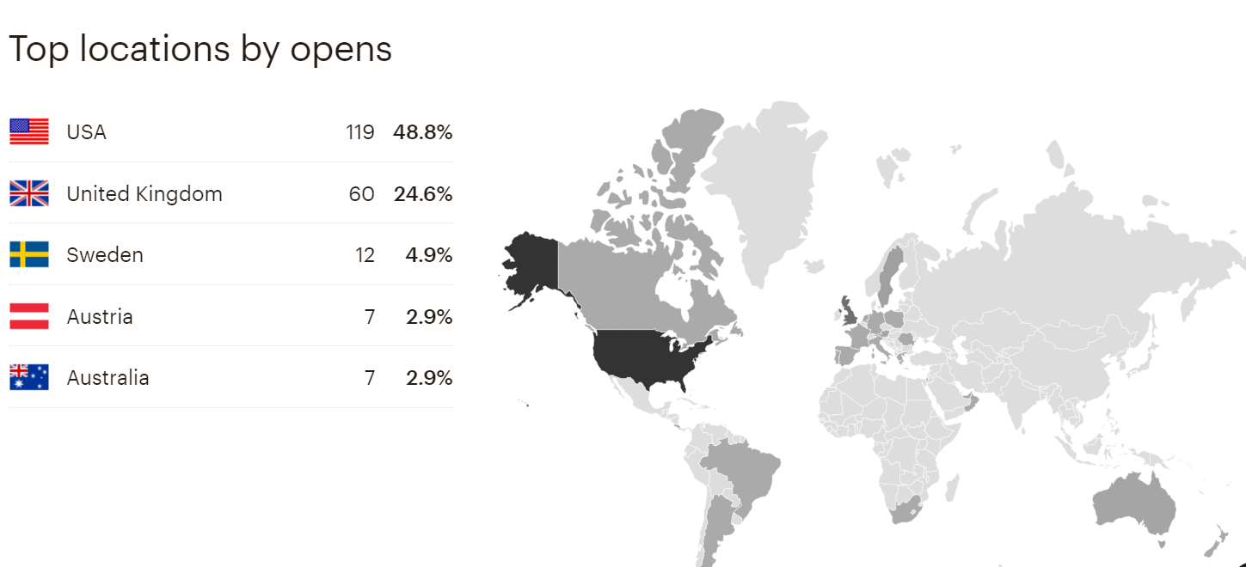
Mailchimp newsletters stay at around 28 % to 31 % open rates.
And we are now steadily gaining more subscribers to Mailchimp

Slide 11
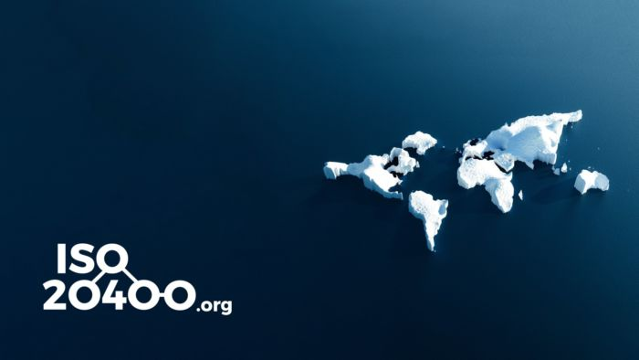
In total we now have over 79,467users who have accessed our resources in over 99,656 sessions ISO20400.org

Slide 12
Social Media engagement continues to attract more followers ….
Our LinkedIn members have increased to 12,532 plus other LinkedIn (3,584) now making 16,116
X ( was Twitter ) has increased to over 630 followers
Our Facebook page “Sustainable Procurement” has 330 “friends” and the 27 groups that follow us collectively have almost 500,000 members in various countries around the world.

Slide 13
Self-Assessment Tool
901 (64 more) organisations or individuals have taken our online self-assessment from 63 countries, from 21 sectors, from all business sizes and in 9 different languages. More than half of these businesses are SME’s
The offline PDF has been downloaded 794 (115 more) times from 9 languages … Arabic, Chinese, Czech, English, French, Germany, Italian, Spanish and Welsh …

Slide 14
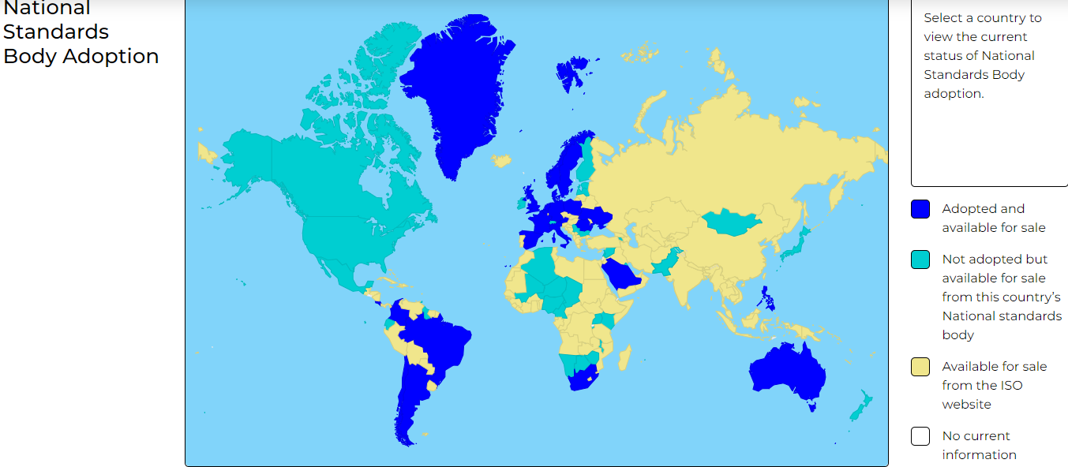
Our interactive world
map is very popular !
And been used 677
times so far.

Slide 15
Thank you for your time
For more information please contact
CaroleASmith@actionsustainability.com
07958 494543
ISO Twenty-Four-Hundred
@ISO_20400
www.iso20400.org

