Slide 1
Steering Group Data Report Monday 15th April 2024

Slide 2
Our mission statement …
ISO20400.org is a not-for-profit, free to access platform which aims to develop a global community of practice around ISO 20400 and sustainable procurement.
Thank you for supporting us !

Slide 3
We are still doing all of this
Who | How | Progress
Targeting Procurement and sustainability professionals | 1:1 engagement, social media, events, marketing | Growth Agency is attracting more users to the website from 12 prioritised countries. We are using Mailchimp newsletters and numbers are growing We are refining what is promoted We use social media weekly We are creating podcasts weekly We have applied to attend a summit in the USA in Nov 2024
Business leaders (C Suite) | Targeted engagement through marketing channels, high level events, articles | Our recent videos and podcasts about getting into a career in sustainability and case studies have proved very popular.
Schools/colleges/universities | Potentially sponsored study in Canada and New Zealand | We are continuing to explore these possibilities with Anne Staal and Luc Bres Encouraging use of ISO20400.org resources in teaching and research We have also made connections with other Universities via their procurement personnel.
Beginners, people given the job to implement SP | 1:1 engagement, recommending resources, social media, events, groups, awards, competitions | Upgrading the Self-Assessment to provide audio guidance is continuing, were at the coding stage now and hope to be completed by the end of April 2024 We are going to record a new video guidance for this. Shaun to feedback

Slide 4
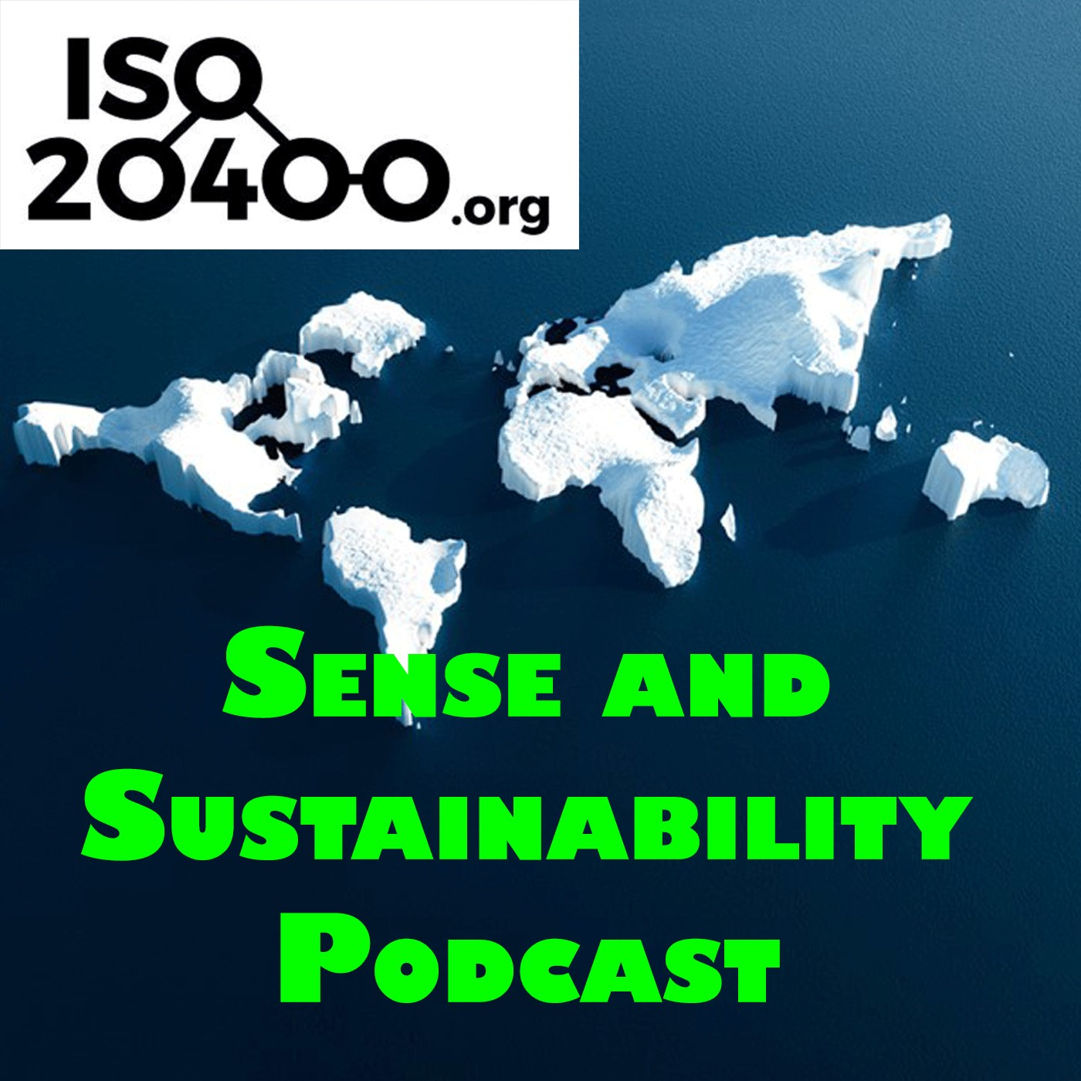
33 Platforms being used
69 Countries in total
565 cities in total
3270 Total downloads
Top 5 Countries: 1st United Kingdom 1063, 2nd USA 411, 3rd Australia 327, 4th Canada 115, 5th Netherlands 96
Top 5 platforms: 1st Apple podcasts 1088, 2nd Spotify 804, 3rd party apple apps 357, 4th Audible 251, 5th Buzzsprout 138
.

Slide 5
Top 3 episodes:
1st Episode 3 - Should sustainable procurement cost more? 237,
2nd Episode 2 - Sustainable procurement it doesn't matter what you call it 221,
3rd Episode 1 - An Introduction to the Podcast 193,
4th Episode 5 - Sustainable procurement international review 179,
5th Episode 4 - ISO 20400 - Do you really need a certificate on the wall? 158

Slide 6
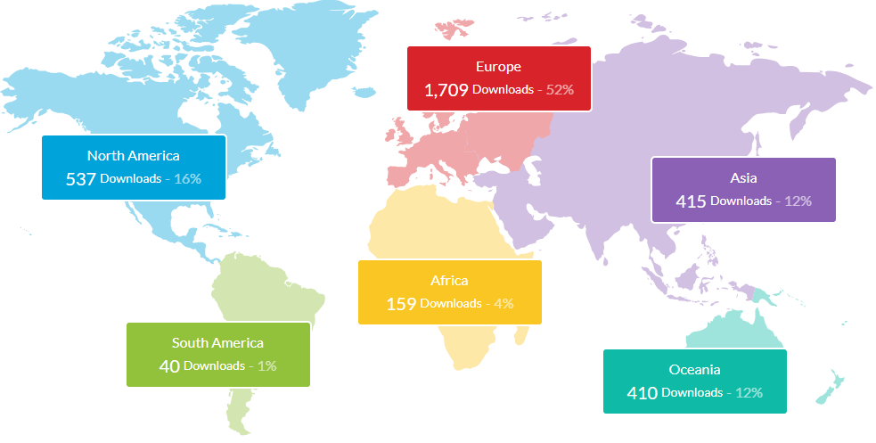

Slide 7
Youtube stats -
105 subscribers
7,111 views
553 hours watched
Top 3 closed caption translations: 1st English, 2nd Chinese, 3rd Spanish.
Subscription Ratio: Non subscribed 91.5% and Subscribed 8.6%
Top 5 Episodes
1st - 5 Years of ISO20400 1,701
2nd Sustainable Procurement Guidance Standards Webinar 298
3rd Episode 18 - SPLC summit with Josh Jacobs 245
4th Plastic packaging tax 199
5th Podcast EP 10 - Sanjay Kumar 168

Slide 8
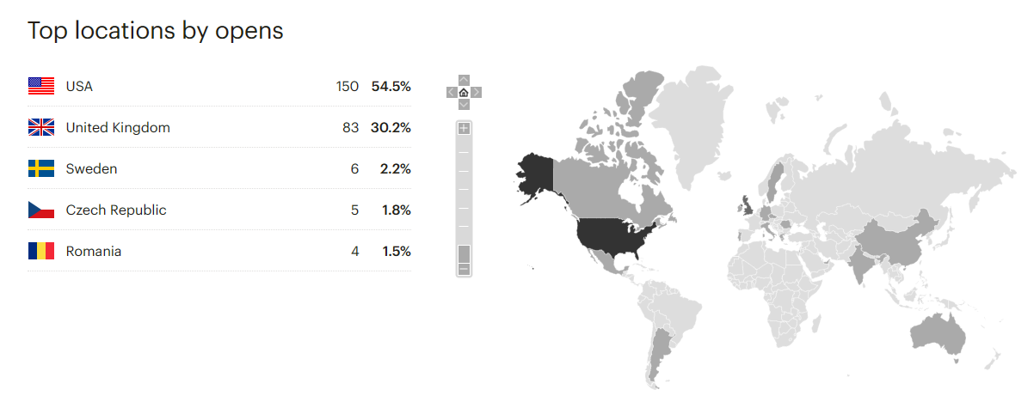
Mailchimp newsletters stay at around 29 % to 31 % open rates.
And we are now steadily gaining more subscribers to Mailchimp

Slide 9
In total we now have over 90,570 users ( 11,103 more) who have accessed our resources in over 108,206 sessions (8,550 more) in ISO20400.org

Slide 10
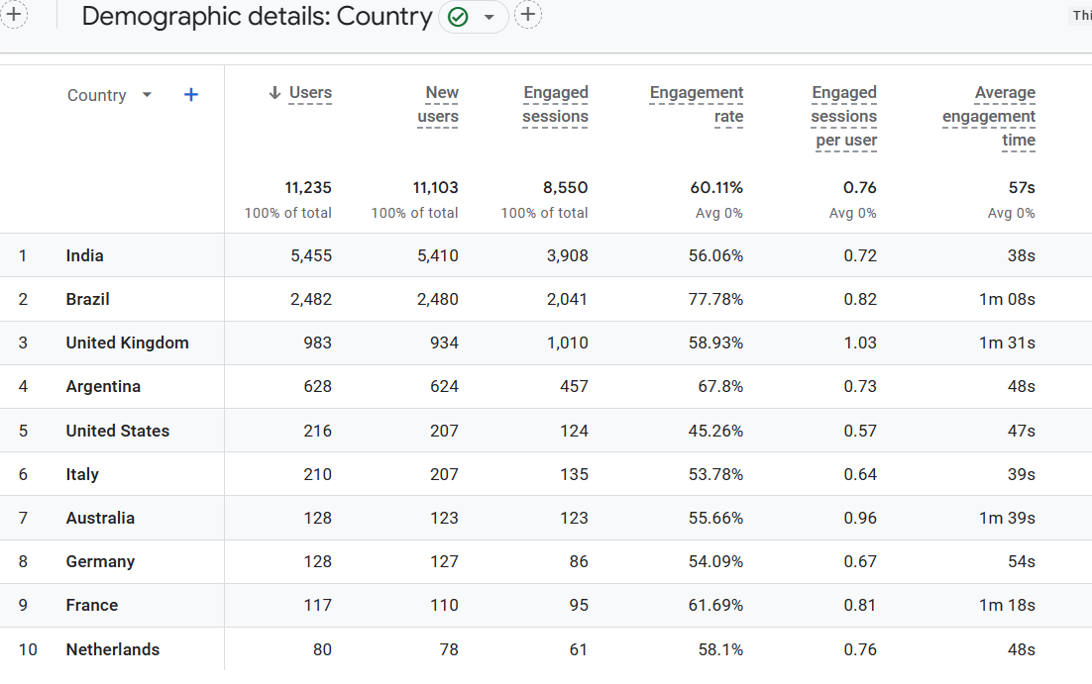

Slide 11
Social Media engagement continues to attract more followers ….
Our LinkedIn members have increased to 12,579 ( 47 more) plus other LinkedIn (3,584) now making 16,163
X ( was Twitter ) has increased to over 630 followers
Our Facebook page “Sustainable Procurement” has 330 “friends” and the 27 groups that follow us collectively have almost 500,000 members in various countries around the world.

Slide 12
Self-Assessment Tool
969 (68 more) organisations or individuals have taken our online self-assessment from 63 countries, from 21 sectors, from all business sizes and in 9 different languages. More than half of these businesses are SME’s
The offline PDF has been downloaded 964 (170 more) times from 9 languages … Arabic, Chinese, Czech, English, French, Germany, Italian, Spanish and Welsh …

Slide 13
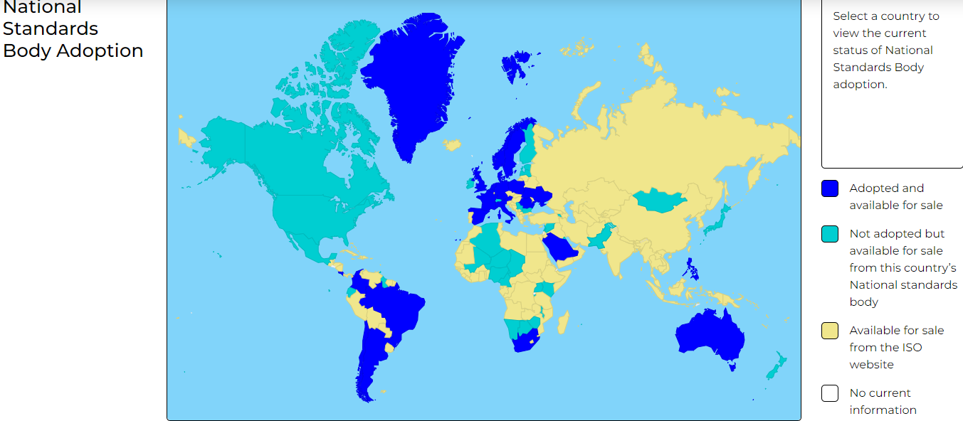
Our interactive world
map is very popular !
And been over 677
times so far.

Slide 14
Thank you for your time
For more information please contact
CaroleASmith@actionsustainability.com
07958 494543
ISO Twenty-Four-Hundred
@ISO_20400
www.iso20400.org

